Slide 1
The Seven Churches of Revelation:
“Pergamun – Standing Against the onslaught of Darkness ”
Part of a study of the Book of Revelation chapters 2 & 3 in which Jesus writes to the Seven Churches in the Province of Asia (now Western Turkey).
By Sunny Daniels, Thurrock Christian Fellowship
12th May 2024

Slide 2
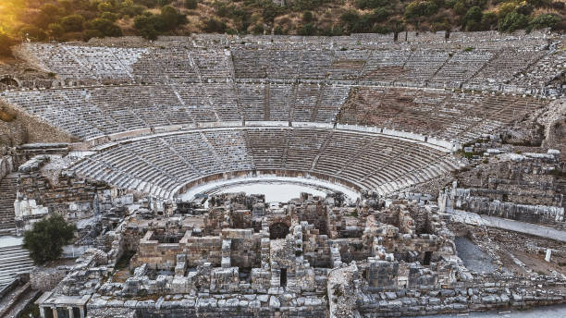
Points to Cover…
Pergamun: its geography, background, and culture
What does Jesus know about them?
Jesus’ message and how it apply to us in TCF today?

Slide 3
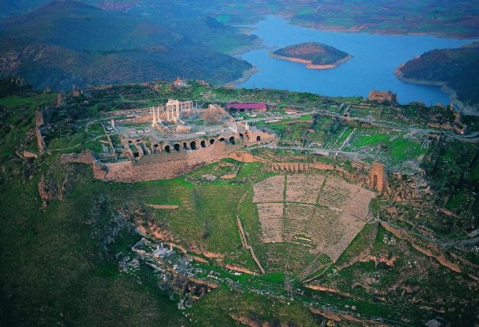
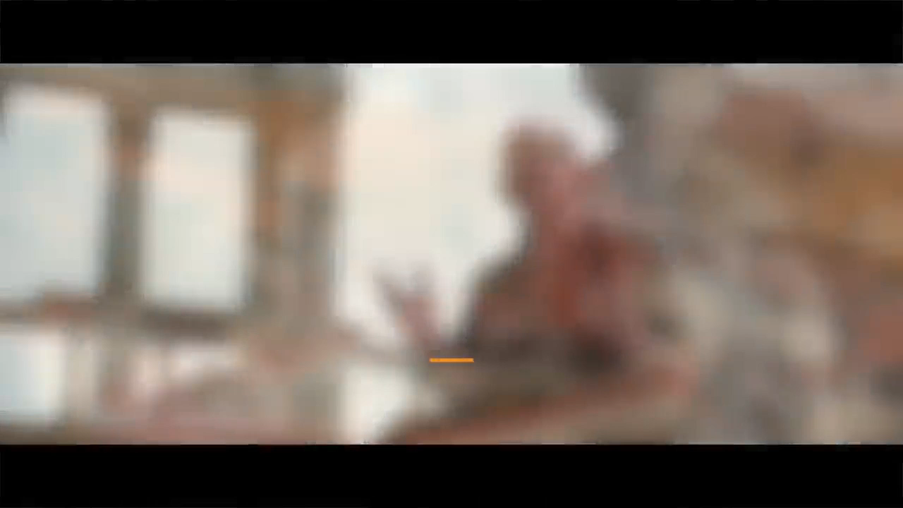
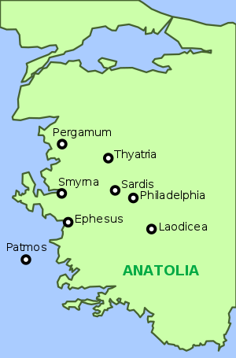
Pergamun, Geography Background and Culture

Slide 4
Revelation Chapter 2: 12 - 17
12 “To the angel of the church in Pergamum write:These are the words of him who has the sharp, double-edged sword.
13 I know where you live—where Satan has his throne. Yet you remain true to my name. You did not renounce your faith in me, not even in the days of Antipas, my faithful witness, who was put to death in your city—where Satan lives.
14 Nevertheless, I have a few things against you: There are some among you who hold to the teaching of Balaam, who taught Balak to entice the Israelites to sin so that they ate food sacrificed to idols and committed sexual immorality.
15 Likewise, you also have those who hold to the teaching of the Nicolaitans.
16 Repent therefore! Otherwise, I will soon come to you and will fight against them with the sword of my mouth.
17 Whoever has ears, let them hear what the Spirit says to the churches. To the one who is victorious, I will give some of the hidden manna. I will also give that person a white stone with a new name written on it, known only to the one who receives it.

Slide 5
How it applies to us in TCF
Today, we’re facing the very same issues that were being faced by believers in the first century. We’re being told to bend our faith, to become more inclusive of other people and other ideas, even inclusive of ideas that are contrary to the teaching of the scripture. You may even feel that pressure from your kids or from your grandkids, your friends, your wife, just like the church in Pergamum, Christ is calling us to make no compromise. This is the doctrine of the Nicolaitans and the teachings of Balak. It tells you to be more accommodating of immorality, of looseness. It tells you once saved always saved. It tells you that devotion to God in prayers is religion. It promotes the God of pleasure and money. It tells you to cast away the fruits of the spirit.
Jesus is saying we should listen to what the spirit is saying to the churches and there will be consequences and rewards. We the victorious ones will be given His hidden manna and He will give us a white stone with a name written on it that only you will know.
Notes:
I have walked around the ruins of ancient Ephesus, which has some of the best-preserved Greek and Roman artifacts.
This is the amphitheatre where the riot in Acts 19 occurred. The acoustics are amazing even today!

